Slide 1
Fraud Transaction Analysis Project
By : Abhay Vardhan Pandey

Slide 2
1. Project Overview
The FinTech industry handles millions of digital transactions daily. With rapid growth comes the challenge of fraudulent activities such as unauthorized access and suspicious behavior. The analyst’s goal is to analyze financial transaction data and detect fraudulent activity patterns.
2. Objective To perform data analysis using SQL and Python (Pandas, NumPy) to identify fraud patterns and provide actionable insights to the FinTech company.

Slide 3
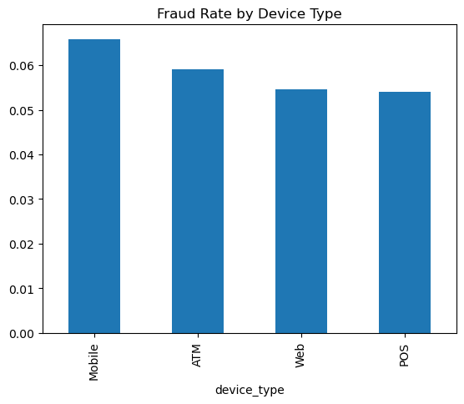
3. Tools & Technologies : SQL, Python, NumPy, Pandas, Matplotlib, Seaborn, Power BI (Optional)
4. Dataset Description Dataset includes columns such as transaction_id, customer_id, transaction_date, transaction_amount, transaction_type, merchant_id, device_type, location, channel, account_balance, and is_fraud.
5. Business Requirement:
1.What is the overall fraud rate? Answer : The overall fraud rate is 5.78%
2. Which transaction types and devices have highest fraud?

Slide 4
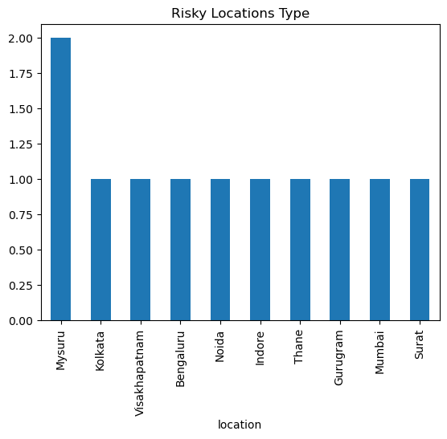
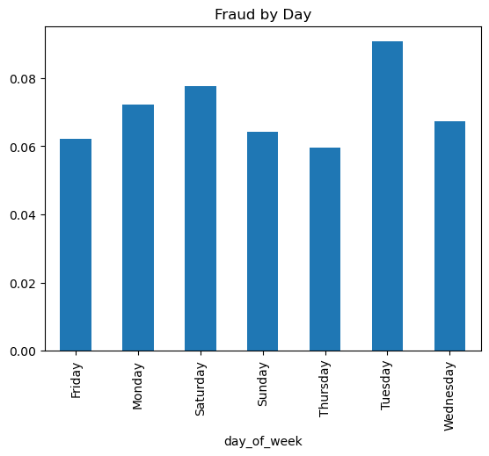
3. What are high-risk customers and locations?
Answer : High risk customer : 2.0 and the location is mysuru .
4. Are certain times more prone to fraud?
Answer : In Thuseday more fraud occur.

Slide 5
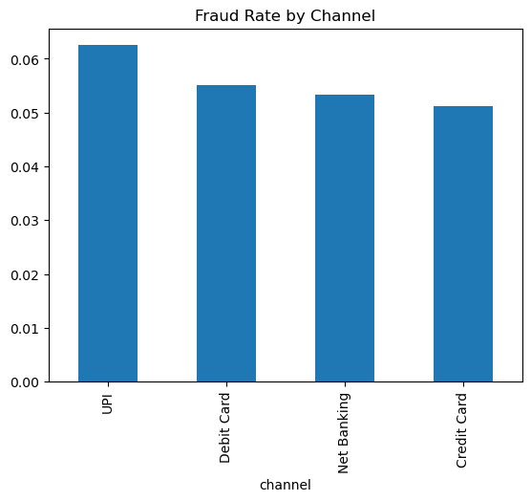
5. Which device type or channel is most risky?
Answer : UPI is the most risky channel.
6. Which customers have the most frauds?
Answer : Customer Id : CUST65770 has more fraud and fraud no is 2

Slide 6
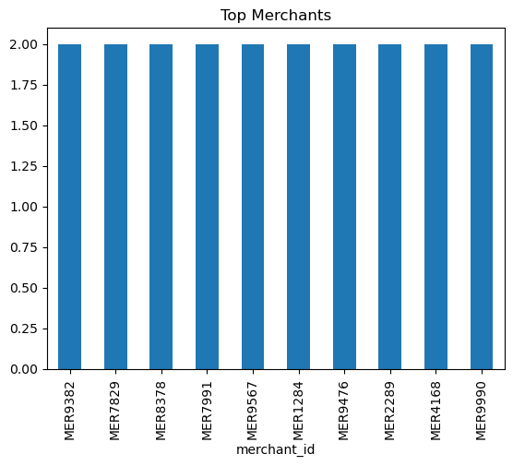
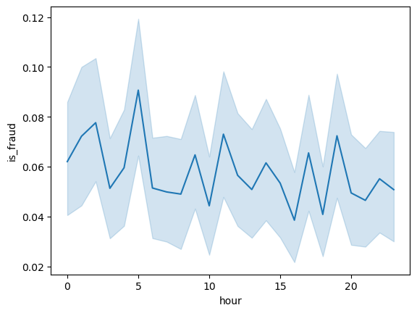
7. Which merchants or regions have repeated suspicious activity?
Answer :
8.Is there a specific time/day
when fraud occurs most?
Answer : Wednesday

Slide 7
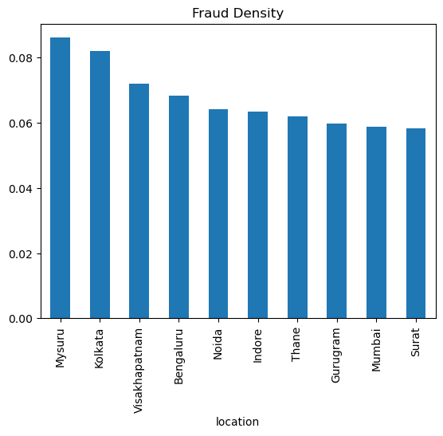
9. Are high-value transactions more likely to be fraudulent?
Answer : High value transaction is 58.21
10.Which locations have the highest fraud density?
Answer : Mysuru is the highest fraud density location .

Slide 8


